Slide 1
Introduction to server-side JavaScript

Slide 2
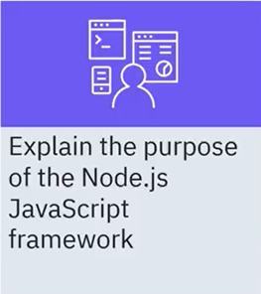
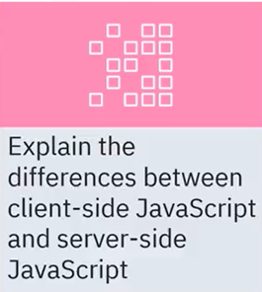
What you will learn

Slide 3
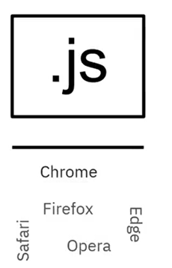
The language of web applications
• JavaScript is a programming language for
client-side interactive web applications that
run in a web browser
• Interpreted language
• Not derived from Java
• JavaScript can run on different servers and
embedded systems
• All modern web browsers support JavaScript

Slide 4
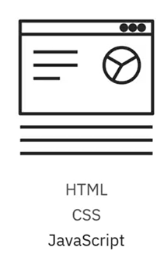
The language of web applications
• Write with a text editor
• Test
• Debug with a web browser

Slide 5




Applications in the web browser
• With client-side JavaScript, developers create rich, interactive
web applications that run in a web browser
Web Brower
Application Server
JSON/HTTP
User interface:HTML/CSS
Enterprise Java Compnents
Rest Service
Business Logic JavaScript
Application
REST Web Service

Slide 6
Recap
In this video, you learned that:
• Node.js is a server-side programming framework that uses JavaScript as its programming language
• With server-side JavaScript, Node.js applications process and route web service requests from the client
• Node.js is for developers who want to build scalable, concurrent server applications quickly with a minimal set of tools

